Slide 1


Women Leaders & Entrepreneurs in Business and Tech
- a Panel Discussion

Slide 2
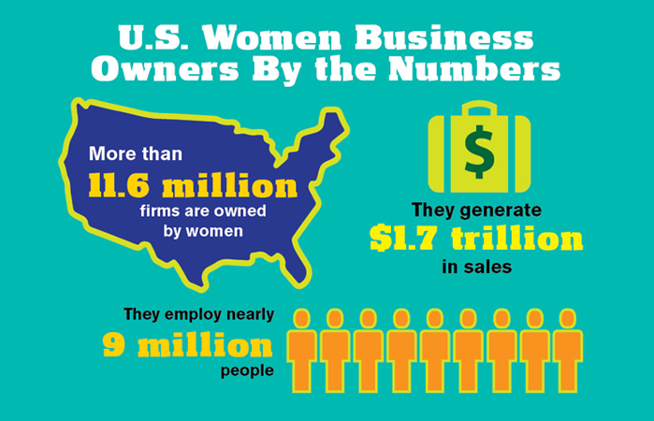
Women In Business
Women Owned Business in the United States
More than 11.6 million firms are owned by women, employing nearly 9 million people, and generating $1.7 trillion in sales as of 2017.
Women-owned firms (51% or more) account for 39% of all privately held firms and contribute 8% of employment and 4.2% of revenues.
Statistics from the American Express OPEN "The State of Women-Owned Businesses 2017”

Slide 3
Women In Business
Businesses Owned by Women of Color
5.4 million firms are majority-owned by women of color in the U.S.
These firms employ 2.1 million people and generate $361 billion in revenues annually.
Statistics from the American Express OPEN "The State of Women-Owned Businesses 2017”

Slide 4
Women In Business
Million Dollar Businesses
One in five firms with revenue of $1 million or more is woman-owned.
4.2% of all women-owned firms have revenues of 1 million or more.
Statistics from the American Express OPEN "The State of Women-Owned Businesses 2017”

Slide 5
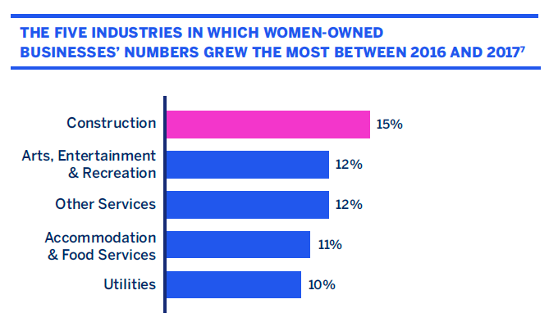

Slide 6
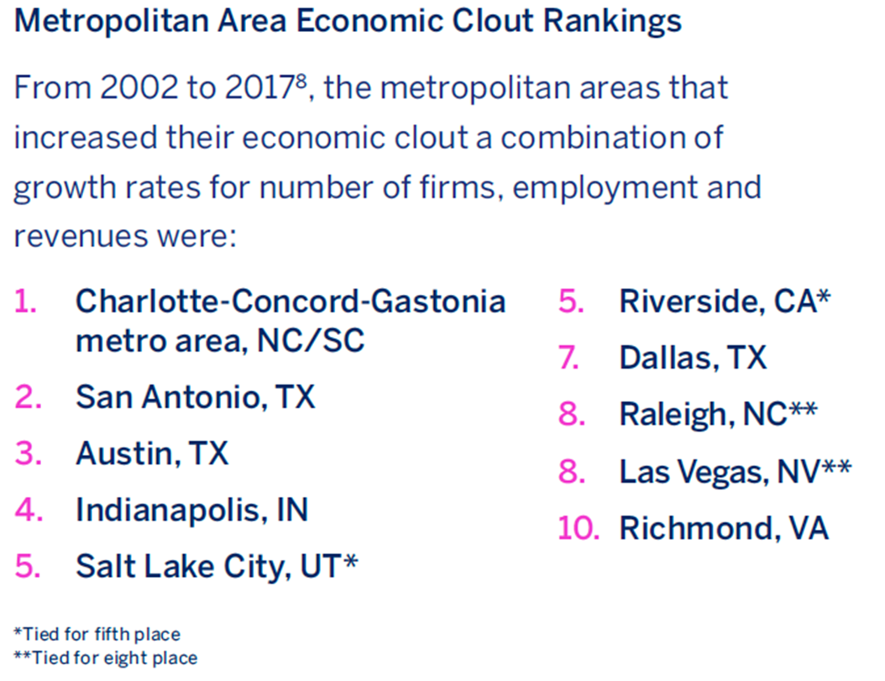
Economic Clout
Economic clout is defined as the growth in the number of firms and growth in employment and revenues

Slide 7
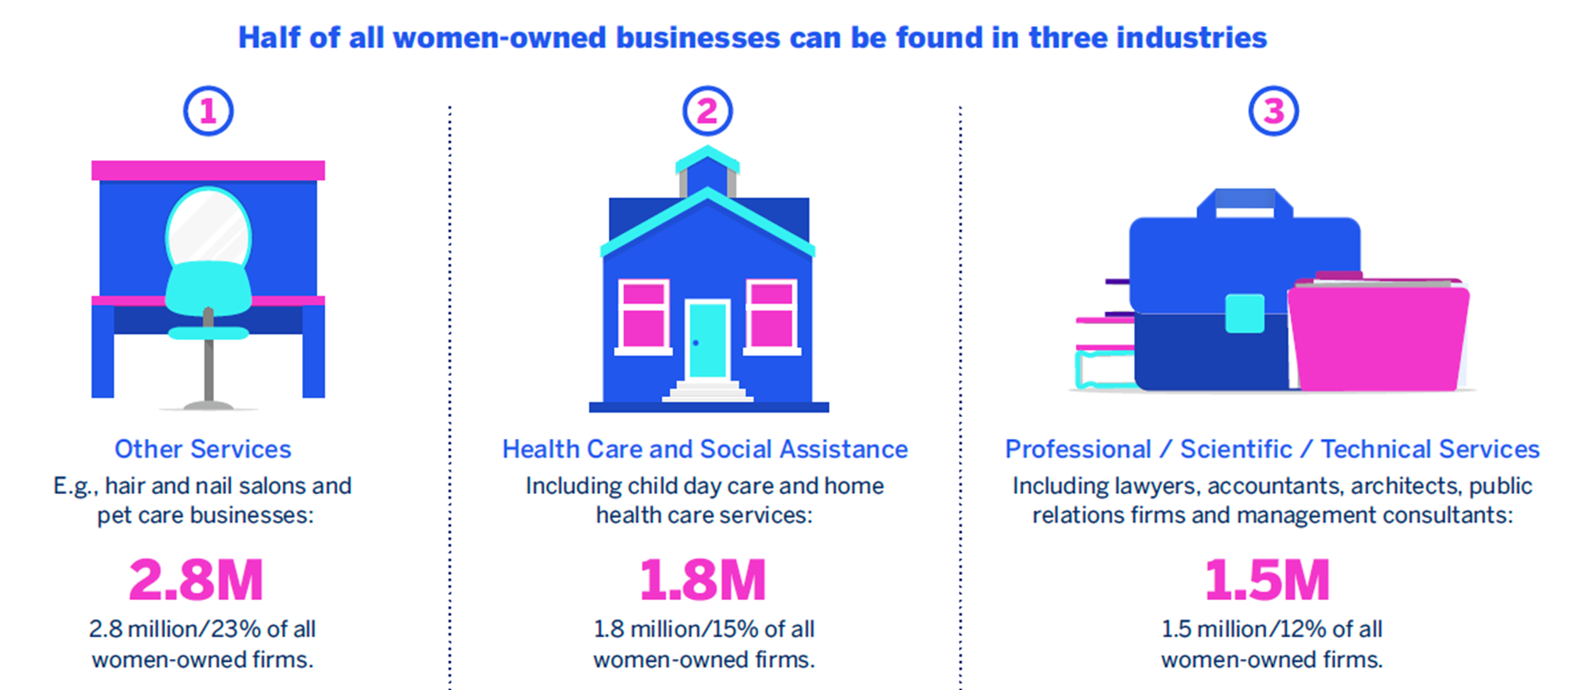

Slide 8
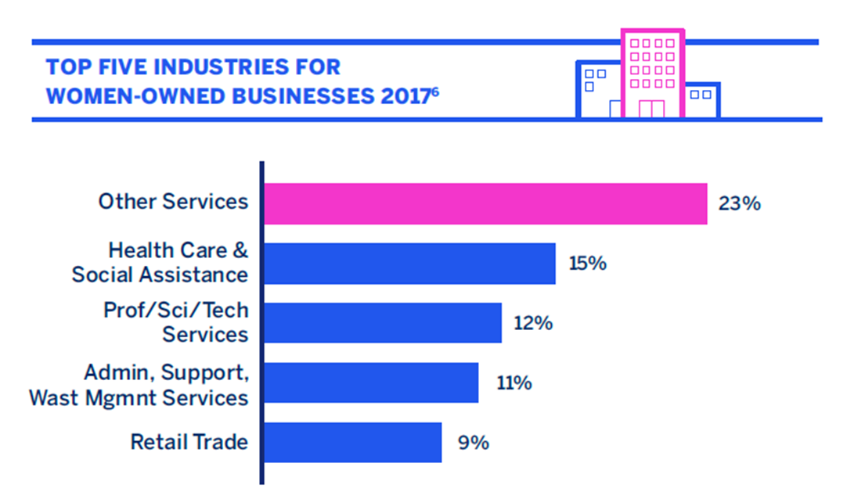

Slide 9
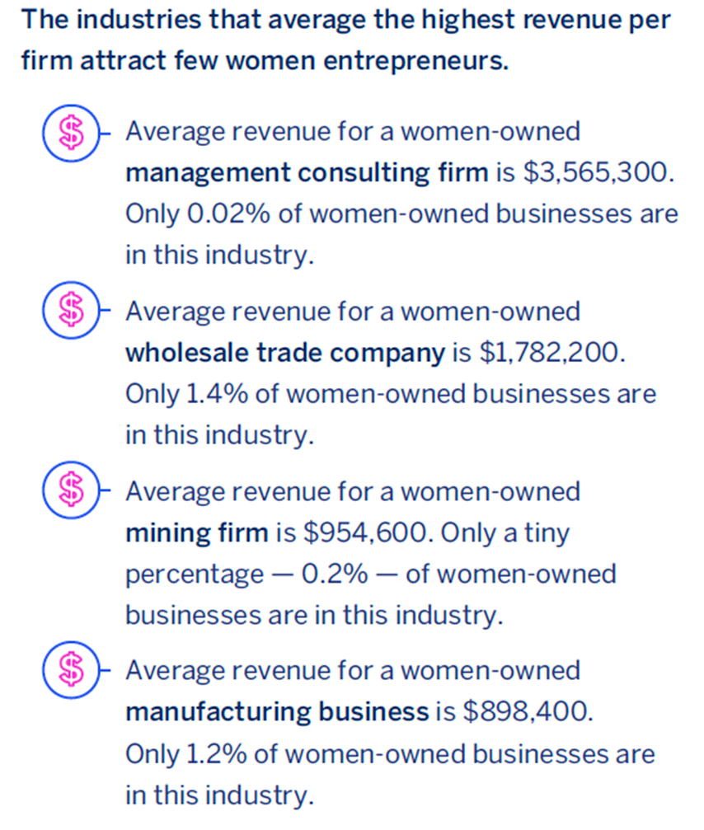
Why do women entrepreneurs tend to focus on lower revenue industries?
Choice?
Barriers to entry?
Lack of interest?
Something else?

Slide 10
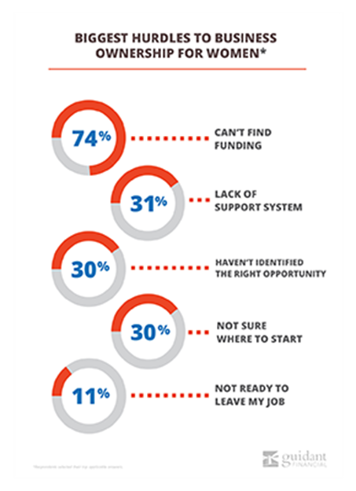
Both men and women cited obtaining funding as the top challenge when opening a business …
But 2x more aspiring female entrepreneurs reported a lack of a support system as a secondary barrier to entry
(the No. 4 challenge for women).

Slide 11
Business loans for women may also be harder to secure… only 6% of women reported they used an SBA loan to fund their business, 24% less than men.
This is consistent with nationwide statistics, which report business loan approval rates for women are 15–20% lower than they are for men.
Despite this, the top funding method aspiring female entrepreneurs pursue is still an SBA loan.

Slide 12
Without access to traditional funding methods, women are left with less access capital to launch their businesses.
Male survey respondents were 19% more likely to invest more than $100,000 in their business.
And when asked about the difficulties of running a business, 10.7% more women listed lack of capital as a top challenge.

Slide 13

Women and Funding
Women at the Top
In addition to being underrepresented as business owners, women are also underrepresented as business leaders.
As of 2017, only 5 percent of CEOs in Fortune 500 companies are women and 20 percent of women are Fortune 500 board members.
Although these numbers are low, they are the highest percentages seen in 22 years, showing positive increases to inclusivity.
One of the reasons women may be underrepresented as business owners is because they are less likely to be funded by venture capitalists. Unfortunately, only 5 percent of all venture capital in 2016 went to women.

Slide 14
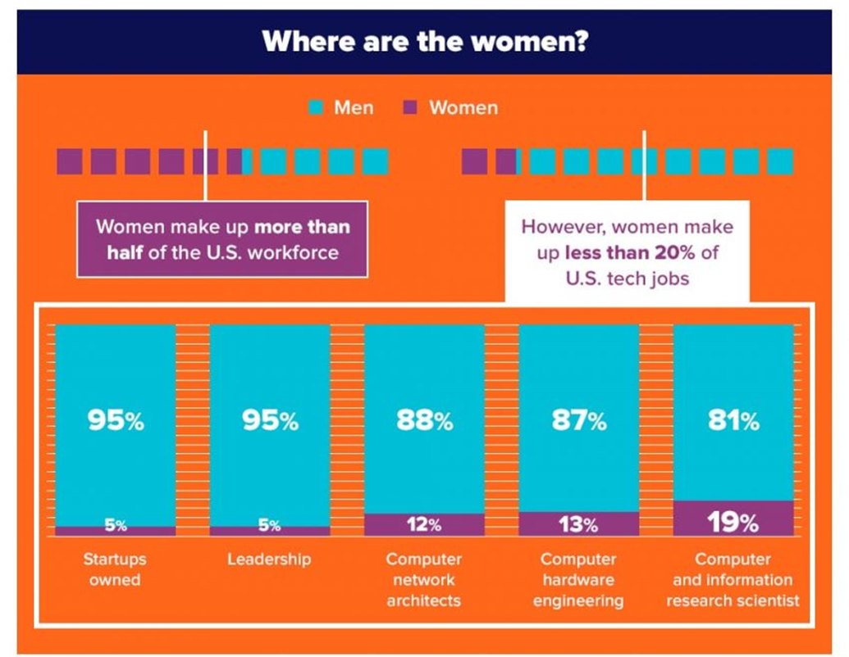
According to data compiled by virtual event solutions company, Evia, women make up less than 20 percent of U.S. tech jobs, even though they make up more than half of the U.S. workforce.
Women now hold a lower share of computer science jobs than they did in the 1980s.
Women receive lower salary offers than men for the same job at the same company 63% of the time

Slide 15
In the high tech industry, the quit rate is more than twice as high for women (41 percent) than it is for men (17 percent).
After peaking in 1991 at 36 percent, the rate of women in computing roles has been in steady decline.
Now, they hold only 25 percent of computing jobs.

Slide 16
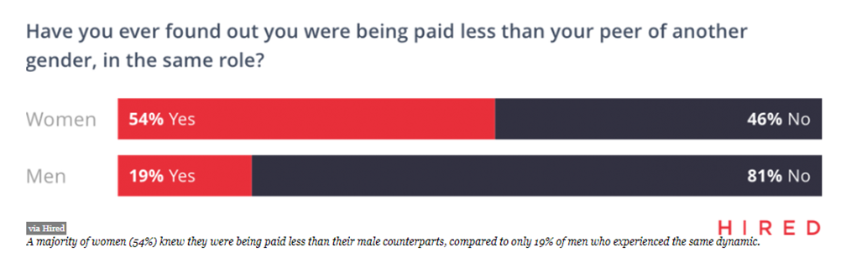
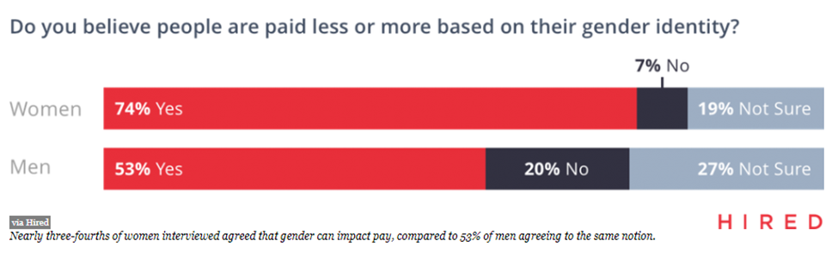
“The State of Wage Inequality in the Workplace.” study by Hired,Inc. finds that 63% of the time, men were offered higher salaries than women for the same role at the same company.
The report found that companies were offering women between 4% and a whopping 45% less starting pay for the same job.
Women in tech also tended to undervalue their market worth, asking for less pay 66% of the time, and would often ask for 6% less salary than their male counterparts.

Slide 17
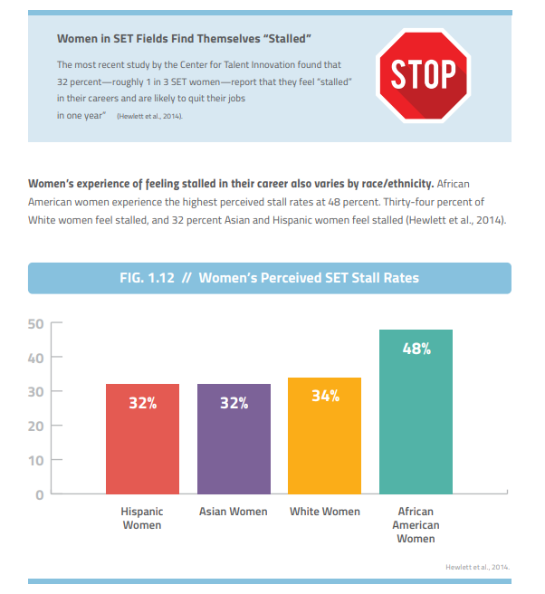
32% of Women in Science, Engineering, and Technology fields feel “stalled out” in their careers and this percentage is higher among African American women in the field.

Slide 18
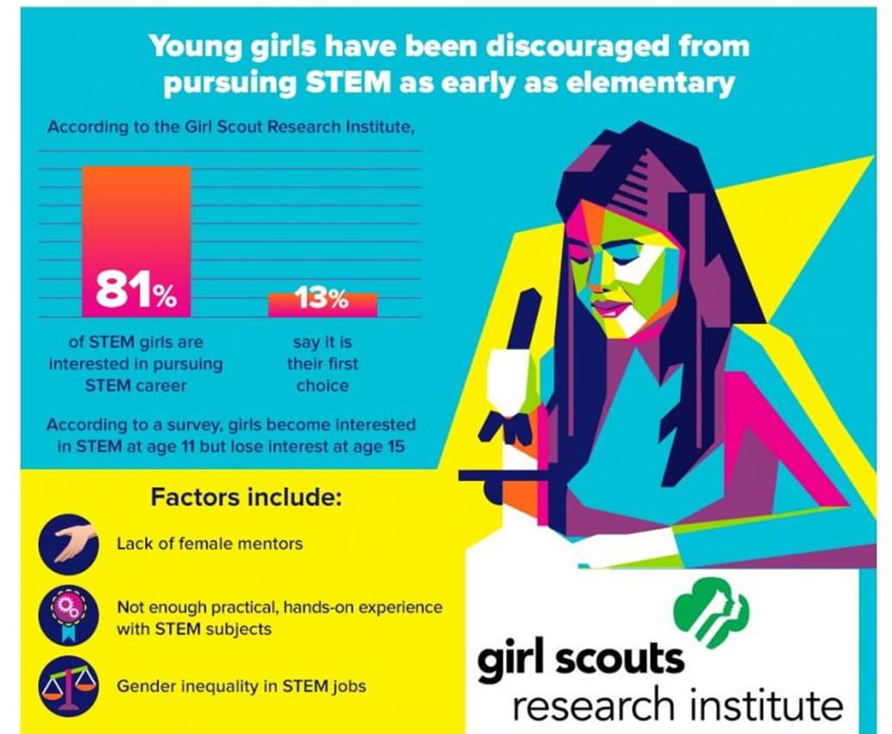

Slide 19
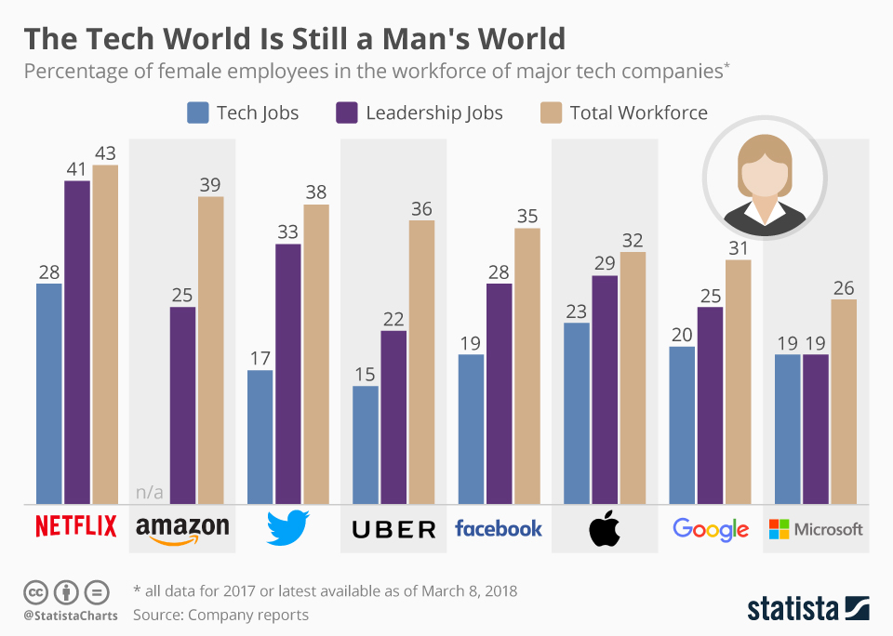

Slide 20
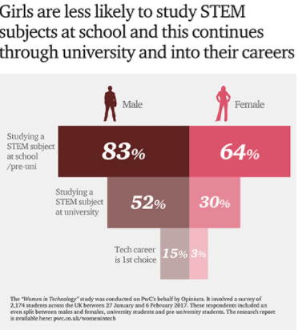

Slide 21
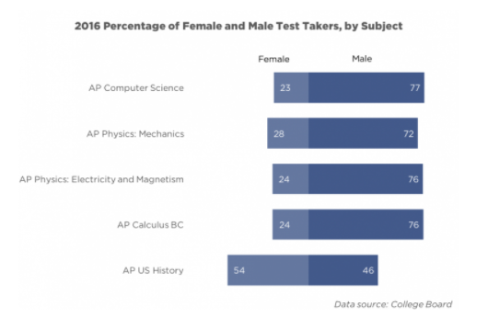

Slide 22
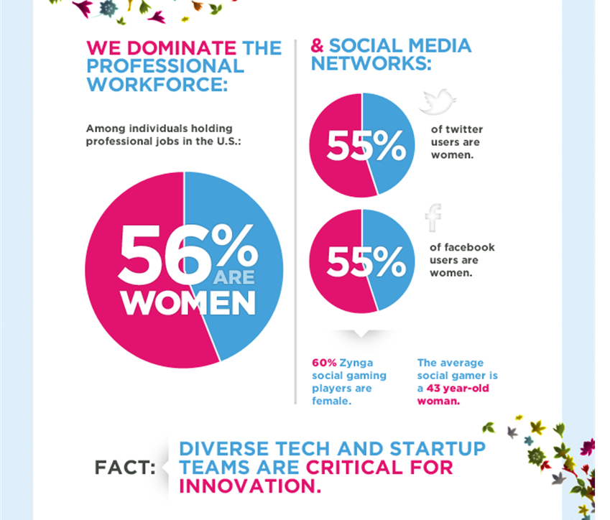

Slide 23
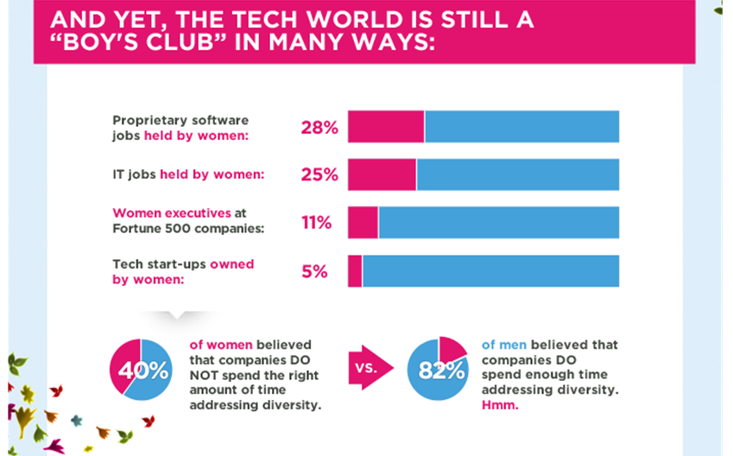

Slide 24
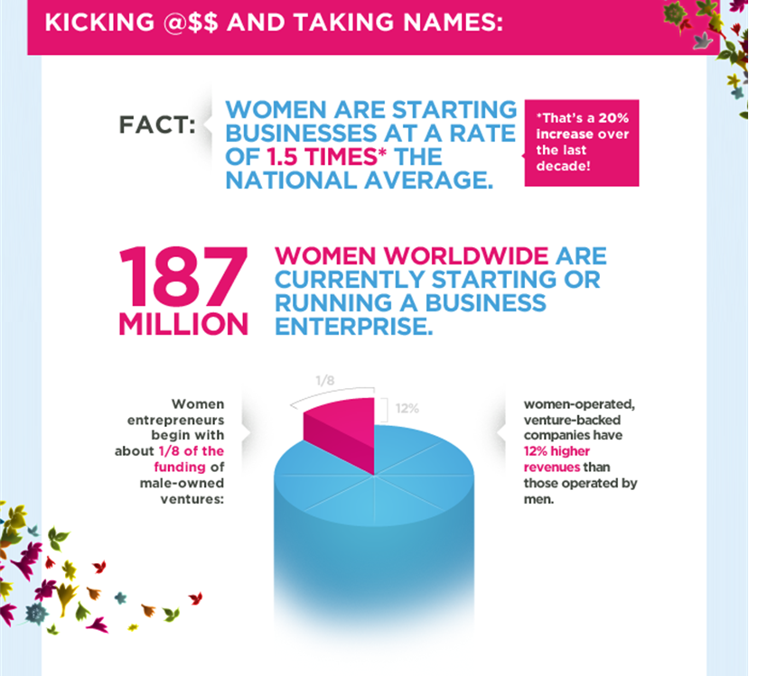

Slide 25
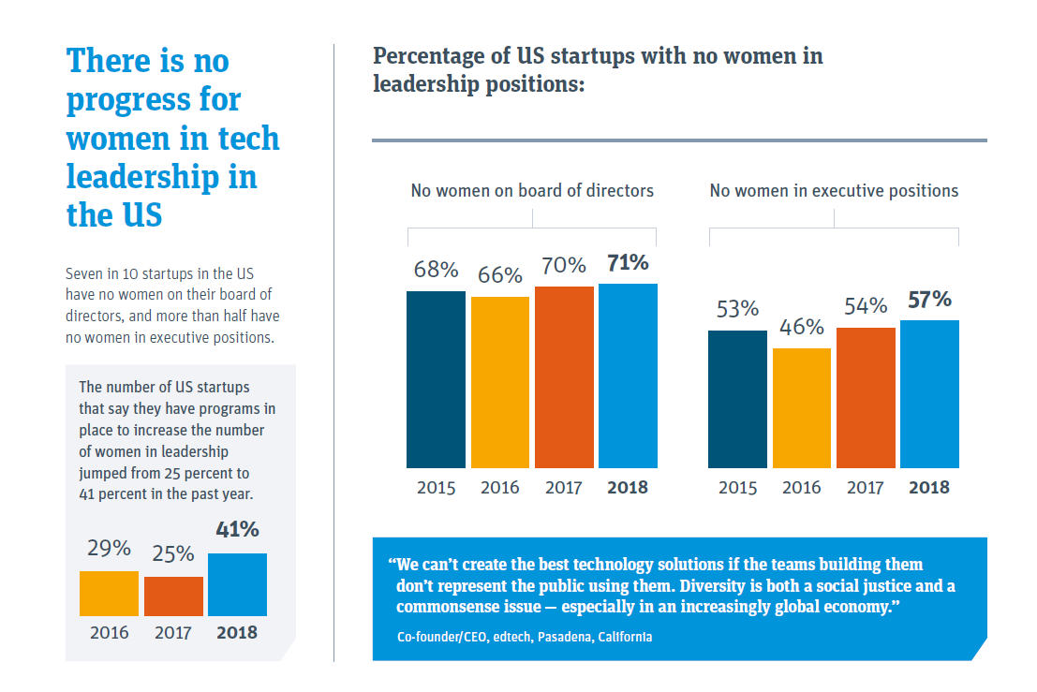

Slide 26
Sources:
https://www.kabbage.com/blog/women-in-business-statistics
http://about.americanexpress.com/news/docs/2017-State-of-Women-Owned-Businesses-Report.pdf
https://www.guidantfinancial.com/small-business-trends/women-in-business/
https://smallbiztrends.com/2018/03/women-in-technology-statistics.html
https://www.womenwhotech.com/womenintechinfographic
http://observer.com/2017/06/women-in-tech-statistics/
https://www.svb.com/uploadedFiles/Content/Trends_and_Insights/Reports/Women_in_Technology_Leadership/SVB-SUO-WomenInTech-report%20Final.pdf
https://www.forbes.com/sites/tanyatarr/2018/04/04/by-the-numbers-what-pay-inequality-looks-like-for-women-in-tech/#43fca7fa60b1
https://www.weforum.org/agenda/2017/08/women-in-tech-gender-parity/
https://www.ncwit.org/sites/default/files/resources/womenintech_facts_fullreport_05132016.pdf

